Slide 1
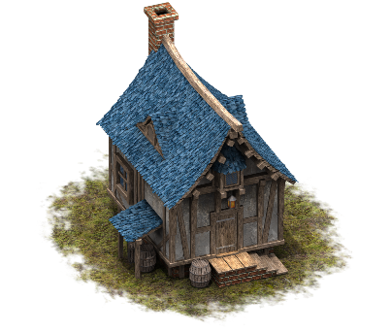
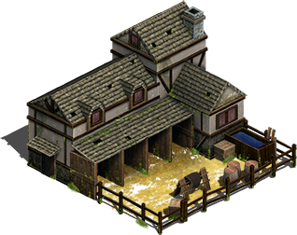
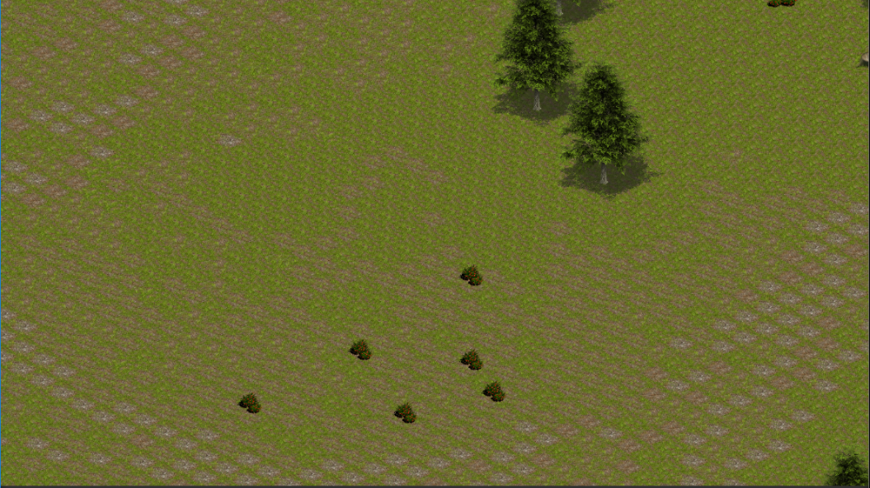
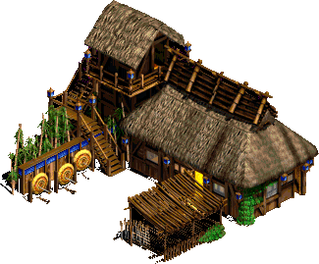
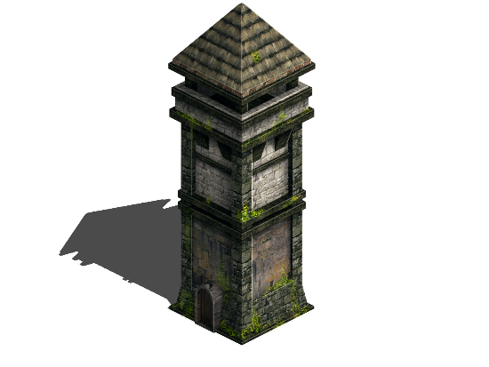

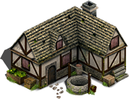
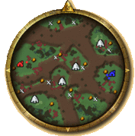
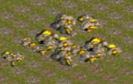

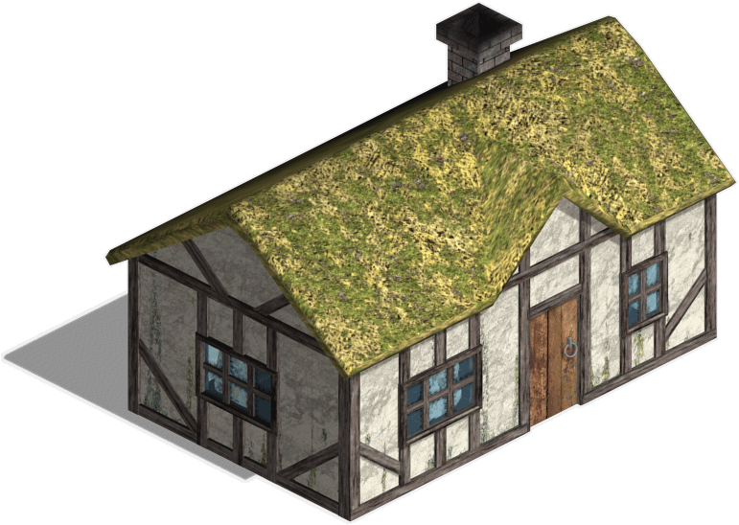
COLONY WAR AVI NEGOSA, SHAI KAIKOV, HODAYA TABIBIAN INSTRUCTOR: DR. DAN OFIR
Menu

Slide 2
The Game
the user builds his colony and fight against enemy
the player and the enemy has soldiers, workers and buildings
the goal of the game is to destroy enemy's buildings

Slide 3
Alternatives & Design Considerations
Alternatives:
Game development: python, c++, c#
Game Art: unity assets store, assets from the web.
Environment: blender game engine, unity
Design consideration
Feedback loops- balances the game from going too fast or slow. It balances between offense and defense of the enemy.
Methods and Algorithms
Distance Algorithms-A* ,IDA*, manhatten distance.
Assignment scoring – assign to each assignment score in order to decide which assignment to do (enemy).

Slide 4
Solution
Gather Tasks
Generate all possible assignments
Sort possible assignments according score
Infrastructure
unity with c# in the reason is the most easy and supportive IDE to develop game app.
we choose assets from the web because it was the most similar to what we want.
Assign task
TASK | PRIORITY
attack | 1
defend | 2
Algorithms , modulation
One problem with the A* algorithm is that if many obstacles block our advance, we need to expand a lot of nodes to reach our destination. This results in a very high memory footprint and low performance. We need to store lots of states.so to solve this-we will improve A* by Region-based A*.the second solution will be Iterative-Deepening A* (IDA*).we choose Assignment scoring to.
Functionality
Destroy building, send workers to find resources, attack soldiers.
UI
isometric view in 2D
Notes:
Infrastracture
unity with c# in the reason is the most easy and supportive IDE to develop game app.
we choose assets from the web because it was the most similar to what we want.
Algorithms , modulation
One problem with the A* algorithm is that if many obstacles block our advance, we need to expand a lot of nodes to reach our destination. This results in a very high memory footprint and low performance. We need to store lots of states.so to solve this-we will improve A* by Region-based A*.the second solution will be Iterative-Deepening A* (IDA*).we choose Assignment scoring to.
Functionality: Destroy building, send workers to find resources, attack soldiers.
UI
isometric view in 2D

Slide 5
Screens
Pause screen
Resources
Menu
RESUME
Game screen
NEW GAME
Menu
MENU
Map
Options
Gold mine

